Slide 1
Julia Processing Layer of Three-Tier Design
Rapidly update results with changing inputs while avoiding costly mistakes
Egan L. Picken, MBA
Executive Compensation Consultant
Arthur J Gallagher, Human Resources Compensation Consulting
Eric Torkia, MASc
Head of Analytics Strategy
Technology Partnerz, [Risk | Decision | Data Science]
July 17, 2020

Slide 2
Abstract
Julia solutions for update-intensive compensation models
Financial results executives are measured against change rapidly affecting their short and long term incentive compensation payouts. In the case of Monte Carlo Simulation of Relative Total Shareholder Return (rTSR) model, inputs and correlation relations change daily. Setting up simulated TSR models in excel using Crystal Ball is initially time-intensive and updates are highly prone to introduce errors.
Using Julia to fetch stock price returns and interest rates specific to each company and duration exponentially increased the bandwidth of analysis.
Updating a 15 company TSR group would take upwards to 4 hours to complete;
Changing array dimensions from samples, underlying volatility and risk-free rates inputs requires numerous intermediate calculations
Multiple Crystal Ball runs eats time and denies any other Excel model work to be completed.
Updating a 153 company TSR group took 1.35 minutes to complete the first run, and 44 seconds once the packages were precompiled.
All intermediate calculations automated by Julia powered APIs, and Monte Carlo simulation with returns correlation matrix via Julia Package MCHammer by Eric Torkia of Technology Partnerz.
Using Julia frees human capital from menial data collection and model audits. Time saved increases thoughtful analysis of the results instead of concern of model accuracy.

Slide 3
Motivation
Running models in Excel just takes too long
Collecting data and auditing results for financial valuation of various stock options type and TSR models has taken place too many late nights in the rush between market close and the next morning’s open. Updating any spreadsheet analysis often leads to heavy debugging due to many data entry and copying errors.
Eric pointed me to Julia, citing it was a natural environment for migrating from Excel simulation to coded solutions. We developed many important risk models surch as Relative Shareholder Return, Performance Stock Options and the like.
After employing Julia in rTSR and other models my bosses were amazed clear reduction in time-to-analysis and results. Using Julia productivity increased the equivalent to two and a half analysts without any added labor expense.

Slide 4
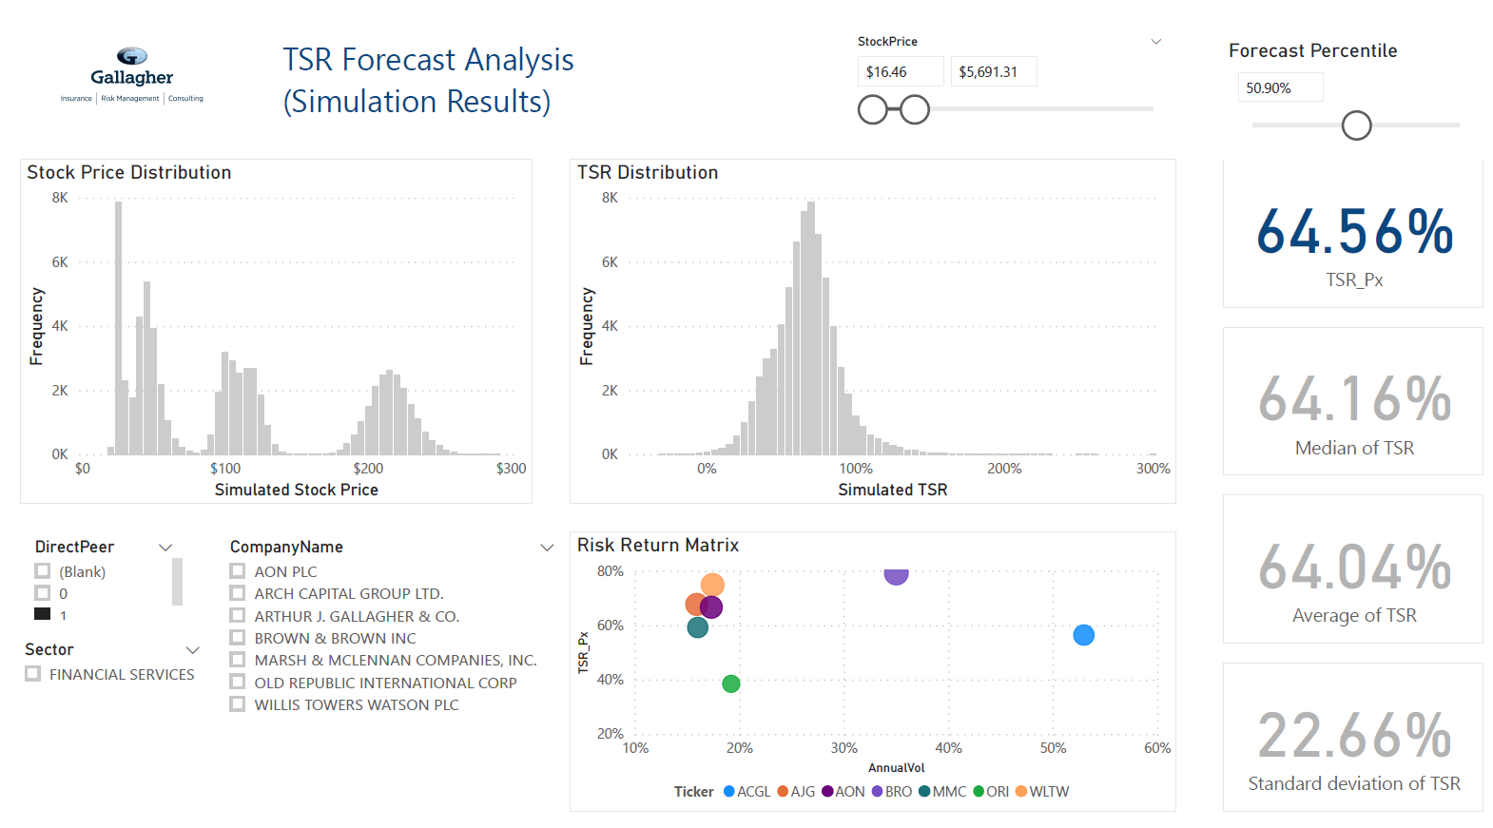
From Julia to PowerBI
Valuation of Financial Based Equity Incentives Inputs:
Risk free rate of US Treasury rates for duration of measurement period as released 430 pm from the Federal Reserve Bank of St. Louis.
Underlying Volatility of returns for each company security at market close
Correlation of returns for each relative peer company and the larger market index DowJones Industrial Average, SP500 or Sector Exchange Traded Fund (ETF).
Long Term relative TSR is measured against the returns of other company stocks on a percentile basis. The median rank among the peer group returns is typically target performance resulting in 100% payout of the incentive opportunity.
PowerBI Dashboard using Julia’s simulation results

Slide 5
Conclusion
Julia increases productivity on a Full time equivalent basis
Further work
Using Julia productivity increased the equivalent to two and a half analysts without any added labor expense. This frees analysts from menial data collection and munging and allows for increased thoughtful insight to the strategic goal of the company by management and greater client engagement, satisfaction and retention.
New Models
API Integration
Parrallelism

